Slide 1
Clarkston Families Decide: An Early Learning and Family Engagement Initiative
June 22, 2016
IEL Family & Community Engagement Conference, Pittsburgh, PA
Roberta Malavenda, Executive Director, CDF: A Collective Action Initiative
Linda Grant, Ph.D., Georgia Piedmont Technical College
Zainab Ali, Consultant, CDF: A Collective Action Initiative

Slide 2
Modeling a Welcoming Environment
Welcoming
Exercises:
Each one greet one
Neighborhood bingo

Slide 3
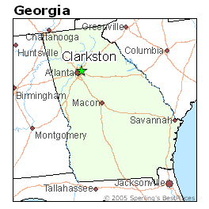
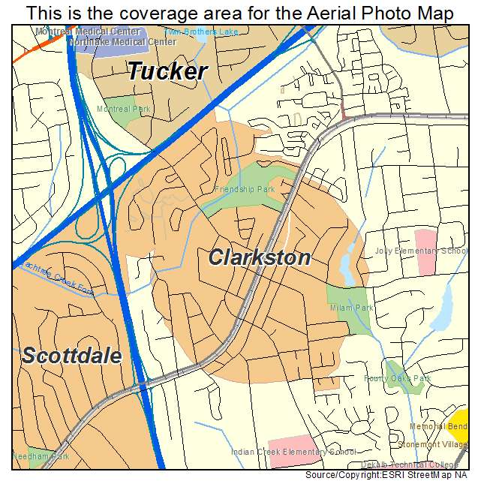
Where we work – Clarkston, GA
“The most diverse square mile in America”

Slide 4
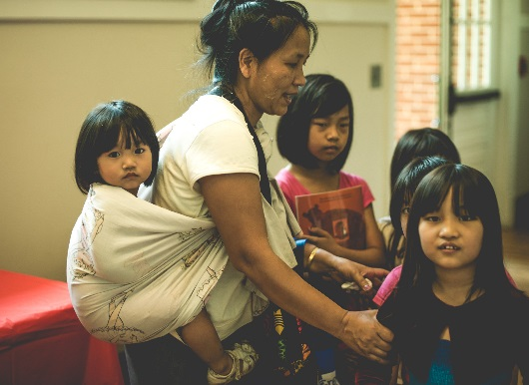
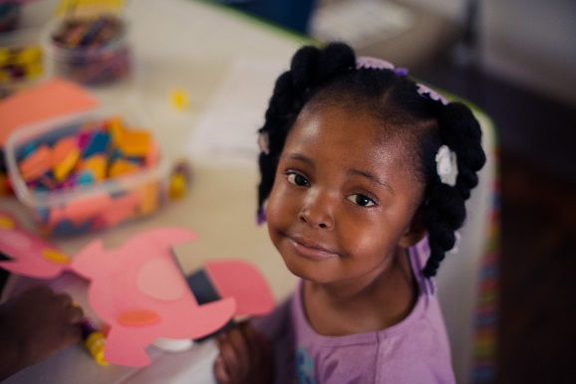
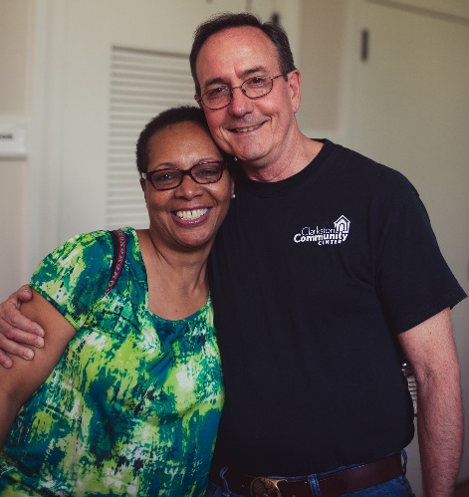
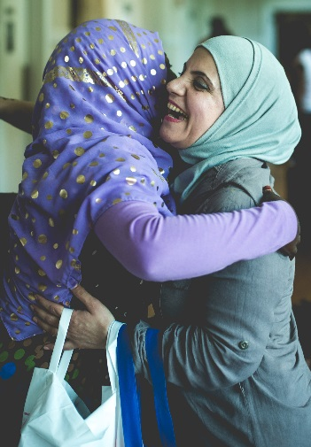
“If you want to see the world, save the cost of a ticket. Come to Clarkston.”
-Basmat Ahmed

Slide 5
About Clarkston
30021 Zip Code
Population just over 22,000
45% Foreign Born
40% US Born African American
13% US Born White
Median HH Income $31,197 (GA: $ 49,736)
Area was identified in 1990s for refugee resettlement
City of Clarkston
Small town feel
Centered around railroad a
Located just east of the intersection of I-285 and Ponce de Leon

Slide 6
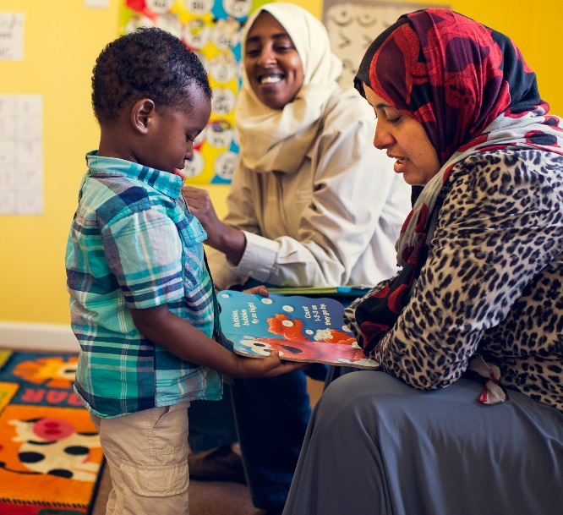
CDF: A Collective Action Initiative
VISION:
The vision of CDF Action is that Clarkston, Georgia will be a thriving, vibrant, and diverse community where all residents’ voices are heard and where all residents work together to transform education.
MISSION:
Our mission is to encourage and equip Clarkston community members to take a leading role in their own futures.

Slide 7
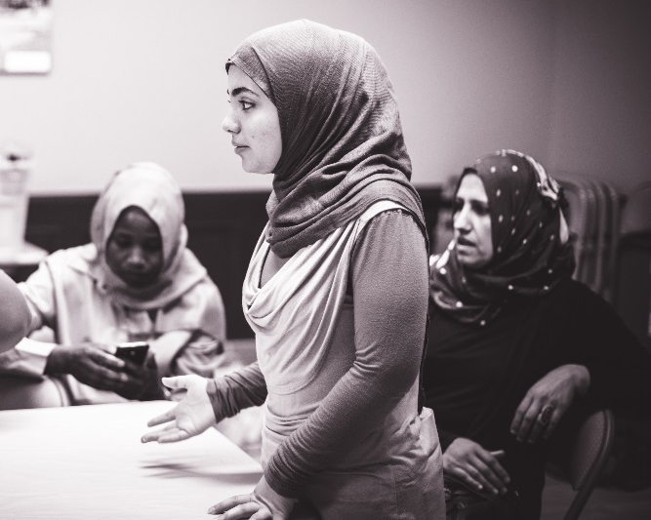
CDF: A Collective Action Initiative
APPROACH:
CDF uses a community building approach through listening to residents, convening dialogues, building on assets and local talents, serving as a catalyst to mobilize new resources and piloting innovative policies, practices, and programs. CDF believes relationships matter and residents will support what they help create.
FOCUS:
CDF focuses on education and works to ensure that all Clarkston children birth to 5 years of age will be nurtured, healthy, and prepared for kindergarten, and all Clarkston elementary, middle, and high school students will have the skills and support they need to graduate from high school and pursue post-secondary education.

Slide 8
Clarkston Families Decide
Funded by the W. K. Kellogg Foundation, CDF works to engage diverse families with children birth to eight to be their child’s first teacher and take actions as leaders resulting in positive changes in early learning and school systems, and in their community.

Slide 9
Clarkston Families Decide
Families become effective advocates for their children and for the community.
Families “own” decisions related to early learning and education outcomes, and will, therefore, commit to and fully engage in the early learning and education systems for the benefit of their children and the community.

Slide 10
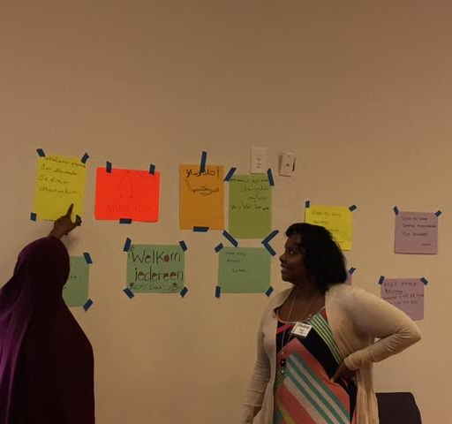
Three Interrelated Components
Early Learning Community Trust
a participatory decision-making process where families designate funds from the trust to an early learning project of their choice based on a set of criteria, such as equity, family engagement, feasibility, and impact.
Family Leadership Workshop, “I am a Leader”
provides opportunities for families from diverse cultures to network and develop skills to assist them in their role as their child’s teacher and advocate and as community leaders.
Countdown to Kindergarten
a campaign to engage Clarkston families, early learning community, local businesses, policy makers and others in a public awareness and community building campaign.

Slide 11
W. K. Kellogg Foundation definition of Transformative Family Engagement
Shared responsibility of families, schools, and communities aimed at helping students learn and achieve. It is a continuous process from birth to third grade and beyond, and occurs across many settings where children learn - creating environments in which empowered parents and families are leaders.

Slide 12
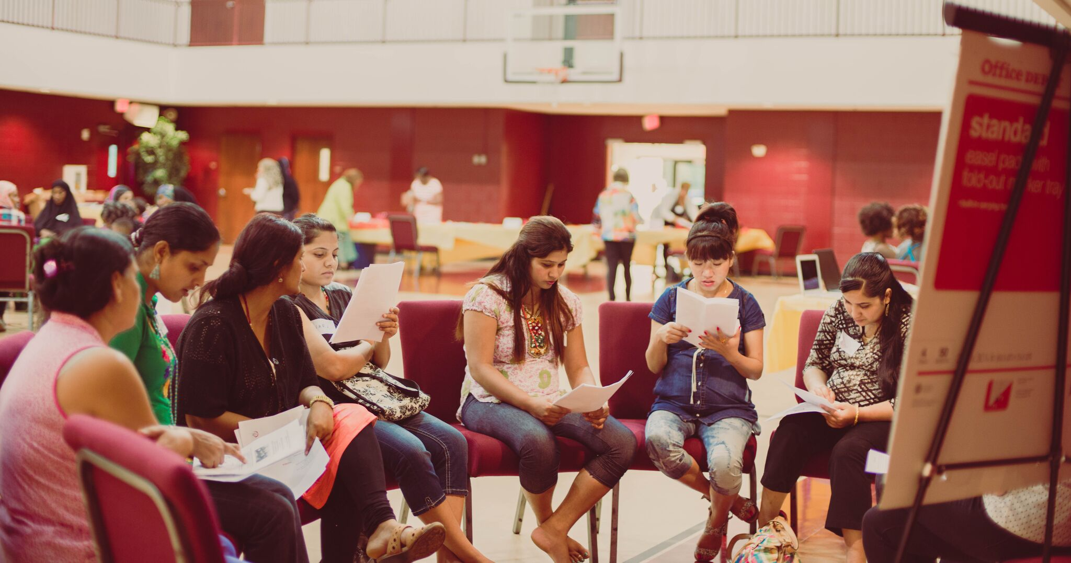
EARLY LEARNING COMMUNITY TRUST (ELCT)
Process that merges two key components:
Community-based participatory decision making to select an early learning theme
Family Engagement

Slide 13
Phase 1 (2014/15): over 100 residents, 4 dialogues, over 7 months, held in large gym and 6 additional meetings with trustees
Phase 2 (2015): 3 dialogues with approximately 40 people at each, representing 4 languages (Nepali, English, Somali, Burmese), over 3 months, held at Georgia Piedmont Technical College
Phase 3 (2016-2017): diverse families whose children attend Indian Creek Elementary School and have children birth to age 8

Slide 15
Facilitator/Note-taker/Interpreter Guide

Slide 16
Group notes

Slide 17
Participant observation report

Slide 18
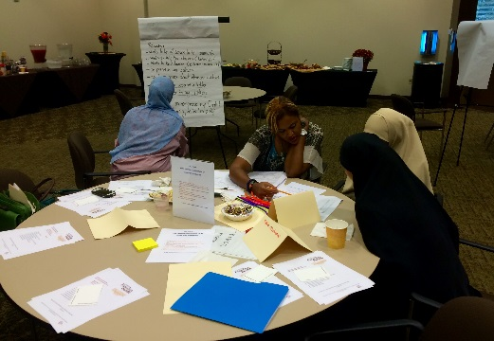
Trust Meetings
Meeting 1
Six (6) small groups - two (2) were conducted in Arabic, one (1) Nepali/English, and two (2) English
Lead Facilitator, Note-taker, Interpreter, and Mentor/Coaches
Initial identification and some prioritization of themes
Meeting 2 – “Over 100 participants”
(7) small groups - one (1) Arabic & Somali; one (1) Arabic only; one (1) Burmese; one (1) Nepali; one (1) Amharic and Dinka; and two (2) English only groups
Further discussion of themes and developing projects

Slide 19
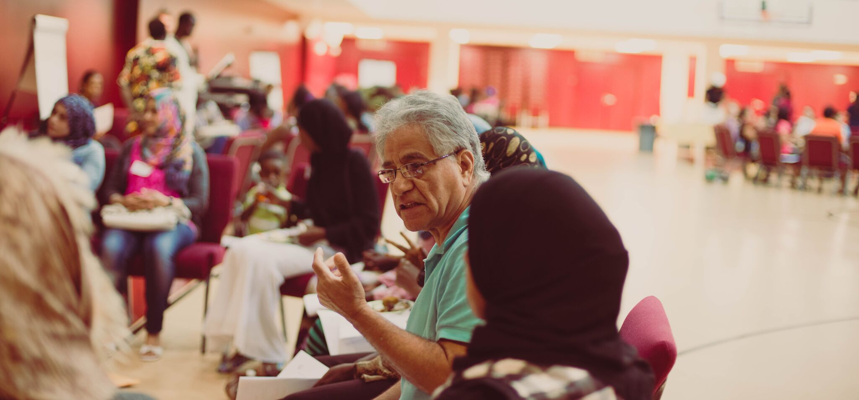
Trust Meetings
Meeting 3
More than 35 participants, speaking 6 languages (Nepali, Burmese, English, Dinka, Arabic, Somali), and approximately 11 assistants (facilitators, note-takers, etc.).
Childcare was provided for approximately 45 young children whose parents attended the meeting and this seemed to be an addition to the trust meeting process.
Selection of trustees and discussion of project feasibility
Meeting 4
75 residents gathered to select the early learning project
6 small groups divided by either languages (Arabic, English) or countries/cultures (Dinka, Somali, Burmese, Nepali-Bhutanese)
Final voting and ranking based on criteria laid out in rubric

Slide 20
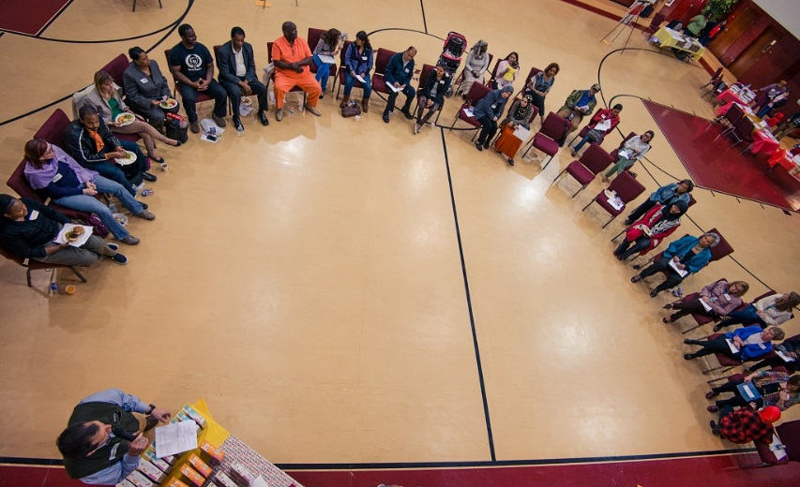
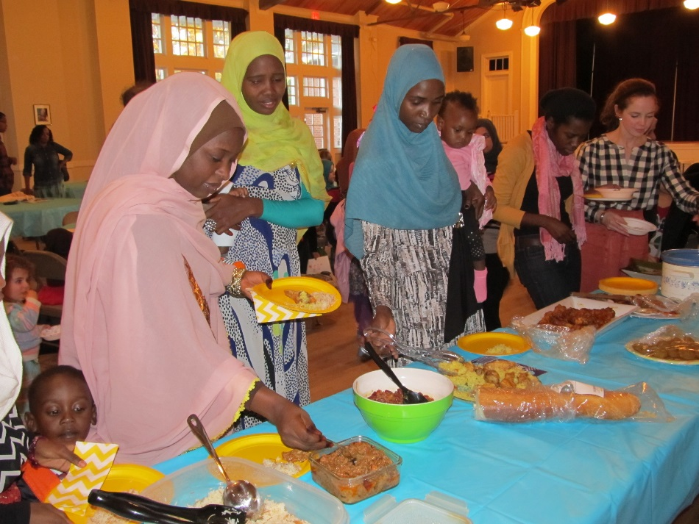
Outcome 1: Creating a welcoming environment
ROLE OF SPACE/LOGISTICS
HUMAN FACTORS
The venues - pros and cons
Room set up
Transportation matters
Hosts and hostesses
Food and networking
Selecting days, time, and dates
Calls and reminders involved engaging partners
The role of culture is pervasive
Facilitators, interpreters, and coaches
Small and large group participation
Free, on-site, quality child care

Slide 21
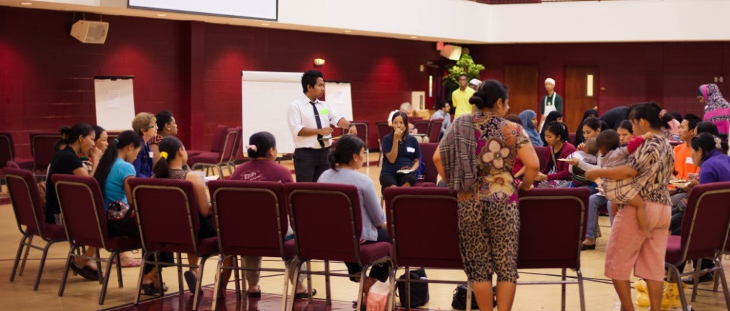
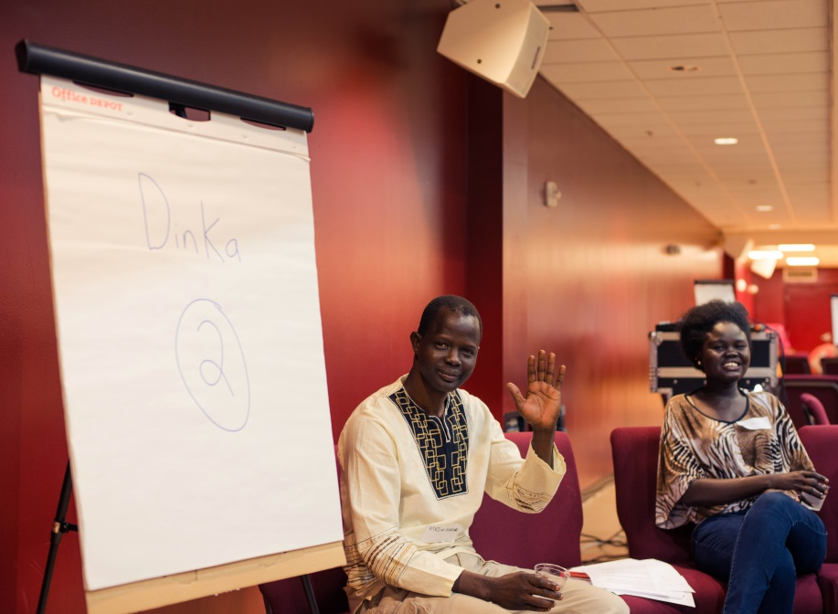
Outcome 2: Making decisions
INFORMATION GATHERED
PROCESS USED
“Dots”
Forced ranking description
Criteria
Ballot and instructions
The math
Forced ranking example
Community Agreements
Identifying issues and projects
Role of Trustees
Analysis and presentation of data

Slide 22
Outcome 3: Creating the Clarkston READY School
Idea developed by families from
Iraq who attended ELCT
Space in their apartment
complex renovated by owner
Multi-lingual teachers hired
Operated by a child care center
Diverse funding

Slide 23
Outcome 4: 2 years in a row, families selected…..
Theme: There are quality early care and education centers serving Clarkston families, where home language and respect for culture are an integral part of the curriculum and where families are trained and employed as aides and teachers.

Slide 24
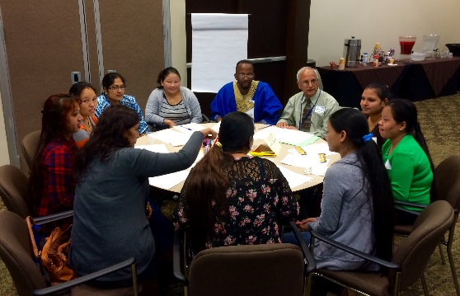
Project selected to be funded with $50,000 from the ELCT
Recruit and train multilingual early learning teachers that reflect the languages of the community in the early learning centers

Slide 25
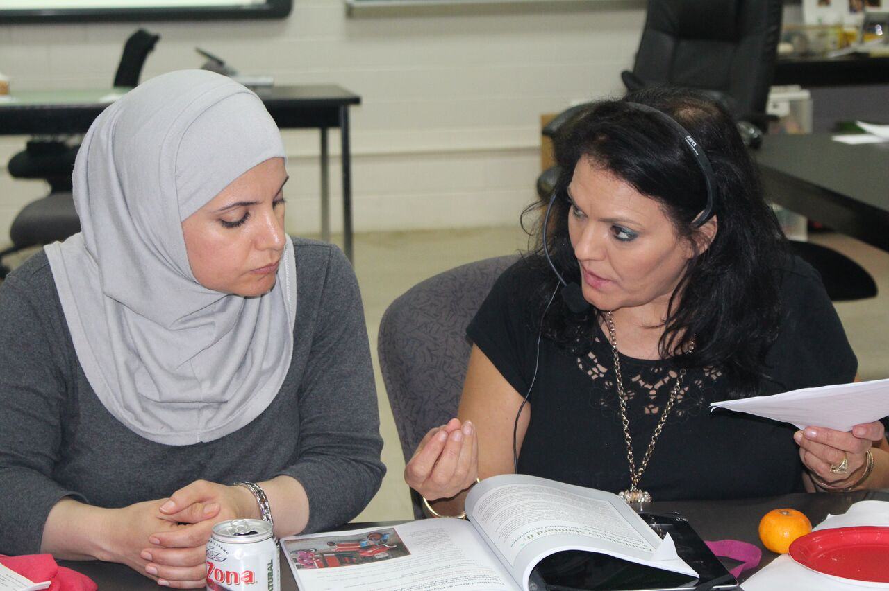
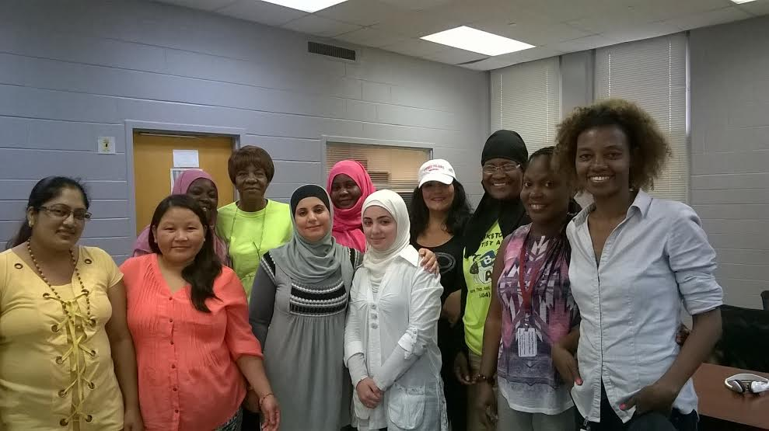
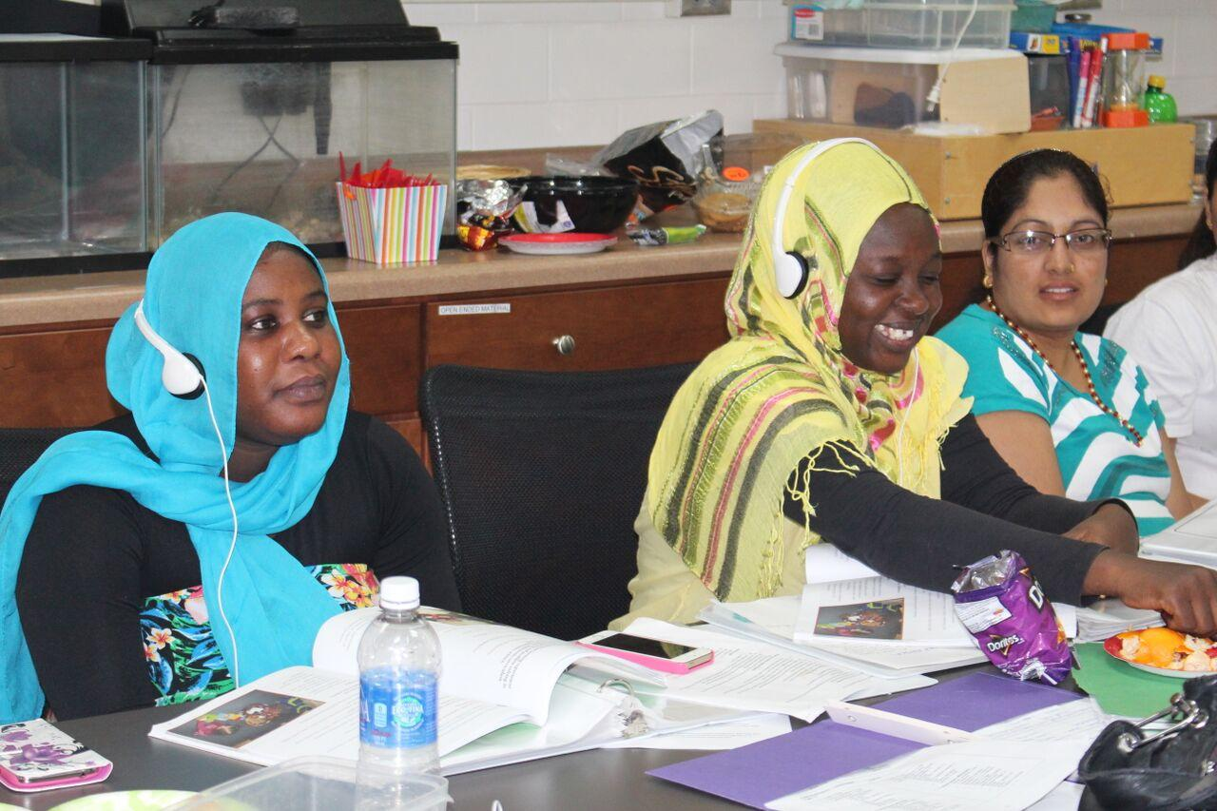
Georgia Piedmont Technical College (GPTC), a community partner with CDF Action, agreed to offer national Child Development Associate (CDA) credential training through Continuing Education…
…to Clarkston refugee women or others interested in early childhood education, many of whom required language assistance.
Students were from Iraq, Sudan, Nepal, Eritrea, and the USA.

Slide 26
Enhanced Child Development Associate (CDA)
Why is it important to have bi-lingual teachers in the early learning classroom?
What does the research tell us?
What are the barriers? How has the Enhanced CDA addressed those barriers?

Slide 27
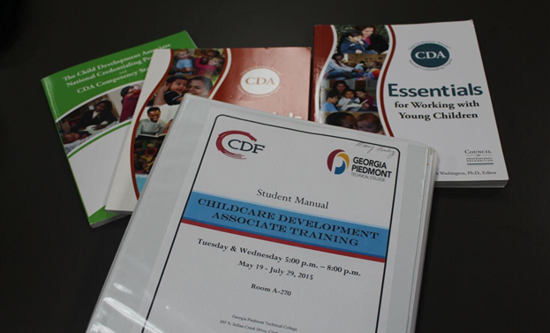
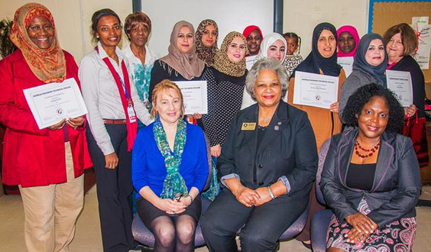
13 students completed 120 hours of CDA training at GPTC
The CDA course was taught in English at GPTC with simultaneous Arabic translation.
All costs for the training was covered by CDF Action with no cost to the enrolled women, including instructor fee, books, notebooks, and CDA credentialing and testing fee.
Access to an Arabic-speaking coach/mentor was provided to those who needed one.

Slide 28
Current progress and status
All students in the first cohort completed 480 hours of professional work with children in a group setting.
The Council for Professional recognition approved an Arabic-speaking Professional Development Specialist (PDS) to complete classroom verification visit and interpret for Arabic speakers; a Somali-speaking early learning professional is going through the process to become a PDS.
Most of the first cohort students have secured full or part-time work with children in Clarkston and in surrounding communities. Three received their CDA credential. Others are waiting to take the exam.
Second Cohort began in May 2016, with diverse students, including Somali speakers.

Slide 29
Committed to program evaluation partnerships

Slide 30
Overall assessment
“CDF Clarkston Families Decide ELCT is an innovative implementation of a community-based participatory decision making model that focuses on a critical issue in a hyper-diverse community where there is little existing structure to support community dialogue. With careful attention to design and context, this model could be implemented in similar communities across the US and the globe.” – Dr. Sherrill Hayes, Associate Professor, Conflict Management, Kennesaw State University

Slide 31
The CDF Action Family Engagement and Early Learning Initiative is a continuous process.
Stay tuned for updates.

Slide 32
We would like to hear from you! For more information:
Website: http://cdfaction.org/
Facebook: CDF: A Collective Action Initiative
Roberta Malavenda: CDF Action, Roberta@cdfaction.org
Linda Grant, Ph.D.: Georgia Piedmont Technical College, grantl@gptc.edu
Zainab Ali: alixx61@umn.edu

